Slide 1
Inclusive Environmental Assessment Guide
Lifetime Partner:
Strategic Partners:
Investment Partners:

Slide 2
ENVIRONMENT MATTERS
You might be surprised to know that physical space is important to people’s sense-of-belonging (or sense-of-exclusion).
The design of physical spaces communicates beliefs about what kinds of people belong in them and what kinds of activities should be done in them.
Think of a time you have experienced being in a place where you felt like you did not belong, a place designed for someone not like you.
(Hattenauer, 1984)

Slide 3
SIGNS AND SIGNALS
The objects, signage, and décor within the environment can signal:
Who does and does not belong
What kind of culture and values the organization has
What is tolerated and respected in the space (and what is not)
What may be expected (or not) from you in that space
(Satterwhite, R., Fleenor, J., Braddy, P., Feldman, J., & Hoopes, L. 2009).

Slide 4
RESEARCH
Research has shown that environmental cues reflecting traditionally “geeky” or “masculine” technology stereotypes can make underrepresented groups feel as though they don’t belong. These cues include:
Typical “man cave” images and objects
Geeky sci-fi or superhero objects (provided such objects are not part of the company’s products or services)
Crude, rude, or sexist posters or signage
“Frat-style” décor
Beer kegs
General uncleanliness
(Cheryan, S., Plaut, V., Davies, P., & Steele, C. 2009)
Notes:
JE: example from Purdie-Vaughns, Davies, Steele & Ditlmann (2008): row of Razor scooters outside an tech company as a cue for an “old school” programmer

Slide 5
INCLUSIVE SPACES
Inclusive signals can broaden who feels a sense-of-belonging in a physical space or even signal welcome to everybody:
Professional, functional spaces
Clean
Gender and race-neutral cues (paintings, plants, positive messaging)
Neutral coloring and bright natural lighting

Slide 6
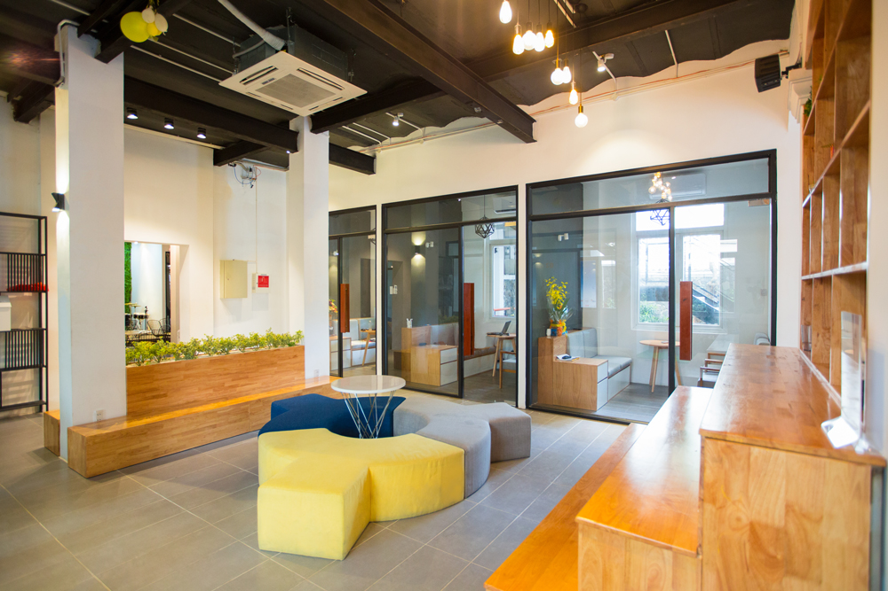
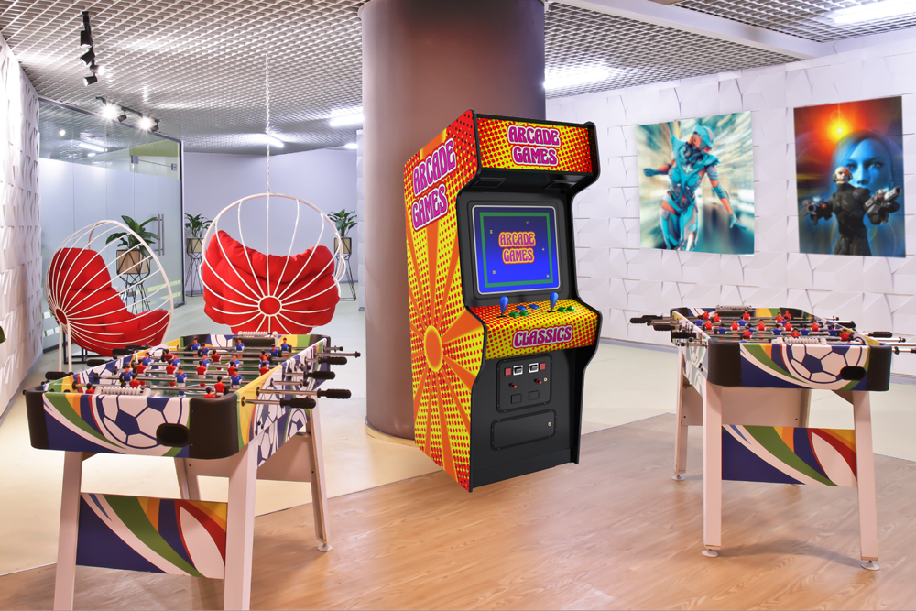
WHAT DO YOU SEE?

Slide 7
USE THE TOOLKIT
STEP 1: Assemble your team and review the research. Go through this presentation together, review the toolkit, and review the research.
STEP 2: Conduct walk-throughs. Use the Tour Notes form in the guide.
STEP 3: Debrief, share, and compare findings.
STEP 4: Conduct the employee physical space survey. There are 6 questions.
STEP 5: Make recommendations.

Slide 8
THINGS TO LOOK FOR
The space design itself (offices, community, cubicles, closet, hallways)
Colors (wall, ceiling, floor)
Décor (pictures, art, statues, toys, plants)
Lighting (dark vs. light, sunlight vs. fluorescent)
Furniture
Signage & Messaging
Accessibility
Other (product displays, games, kegs, room name, visitor areas)

Slide 9
ADDITIONAL RESOURCES
Physical Environment Case Study
How Does the Physical Environment Affect Women’s Entry and Persistence in Computing?
Strategic Planning for Increasing Women’s Participation in the Computing Industry

